Slide 1
St. Louis Central Corridor West Building Permits
Monthly Report: January 2021

Slide 2
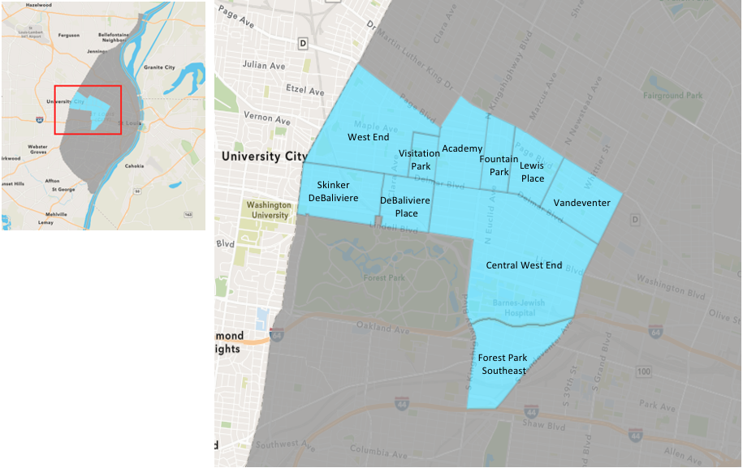
St. Louis Neighborhood Spatial Reference

Slide 3
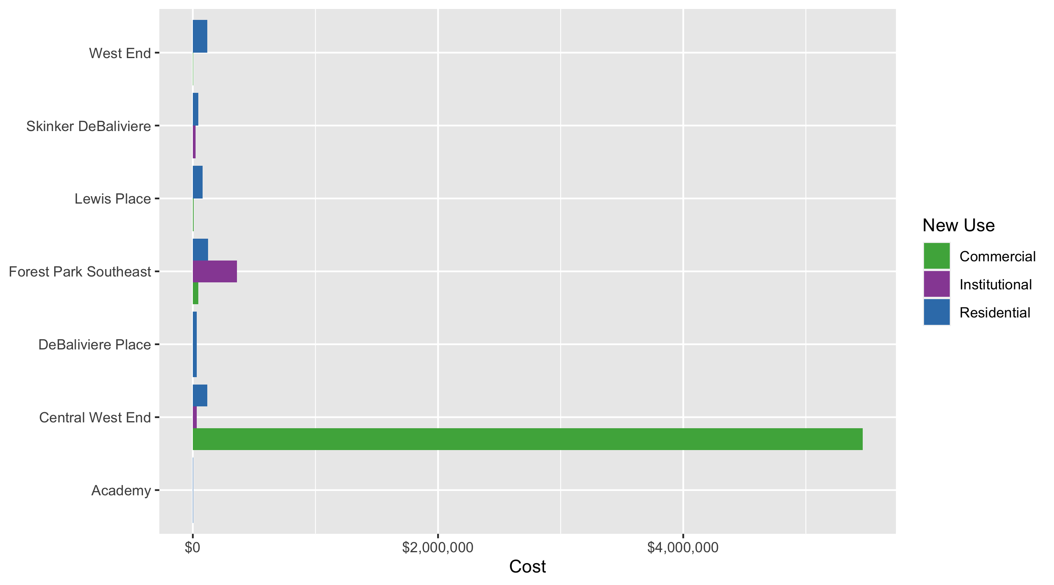
Neighborhood Summary: Average Building Permit Cost

Slide 4
Neighborhood Summary
January 2021 | January 2021 | January 2021 | January 2021
Neighborhood | Average Cost | # of Permits | Total Value of Permits
Academy | $4,475 | 1 | $4,475
Central West End | $1,169,699 | 30 | $35,090,968
DeBaliviere Place | $31,735 | 3 | $95,204
Forest Park Southeast | $142,123 | 23 | $3,268,827
Fountain Park | $0 | 0 | $0
Lewis Place | $54,867 | 3 | $164,600
Skinker DeBaliviere | $42,478 | 14 | $594,692
Vandeventer | $0 | 0 | $0
Visitation Park | $0 | 0 | $0
West End | $101,310 | 7 | $709,167
Last 6 Months | Last 6 Months | Last 6 Months | Last 6 Months
Neighborhood | Average Cost | # of Permits | Total Value of Permits
Academy | $25,198 | 23 | $579,544
Central West End | $433,492 | 217 | $94,067,668
DeBaliviere Place | $358,267 | 36 | $12,897,601
Forest Park Southeast | $3,904,529 | 85 | $331,884,968
Fountain Park | $102,500 | 2 | $205,000
Lewis Place | $32,725 | 17 | $556,323
Skinker DeBaliviere | $59,212 | 60 | $3,552,714
Vandeventer | $35,219 | 9 | $316,972
Visitation Park | $20,554 | 4 | $82,218
West End | $84,106 | 51 | $4,289,407

Slide 5
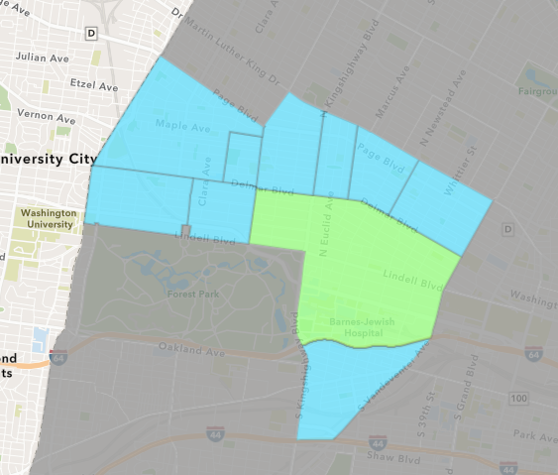
Central West End
January 2021 Neighborhood Cost Breakdown
Mean: $1,169,699
Median: $32,194
Range: $1,500 - $32,034,233

Slide 6
Central West End: Summary Notes
30 building permits in January 2021
-14.29% change compared to January 2020 (35 total building permits)
$1,169,699: Average building permit cost in January 2021
135.27% change compared to January 2020 ($497,175)
30 total building permits in 2021
-14.29% change YTD compared to this time in 2020 (35 total building permits)
$1,169,699: YTD average building permit cost in 2021
135.27% change YTD compared to this time in 2020 ($497,175)

Slide 7
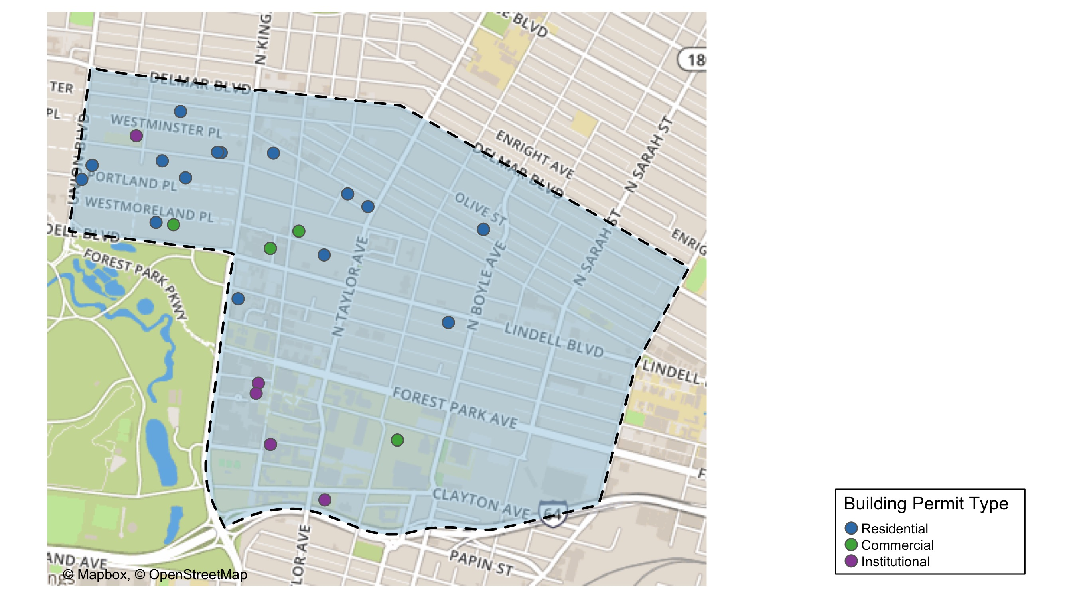
Central West End

Slide 8
Neighborhood Summary
January 2021 | January 2021 | January 2021 | January 2021
Permit Use | Average Cost | # of Permits | Total Value of Permits
Commercial | $5,462,656 | 6 | $32,775,938
Industrial | $0 | 0 | $0
Institutional | $30,695 | 6 | $184,170
Residential | $118,381 | 18 | $2,130,860
Last 6 Months | Last 6 Months | Last 6 Months | Last 6 Months
Permit Use | Average Cost | # of Permits | Total Value of Permits
Commercial | $979,261 | 36 | $35,253,387
Industrial | $0 | 0 | $0
Institutional | $249,405 | 63 | $15,712,522
Residential | $365,269 | 118 | $43,101,759

Slide 9
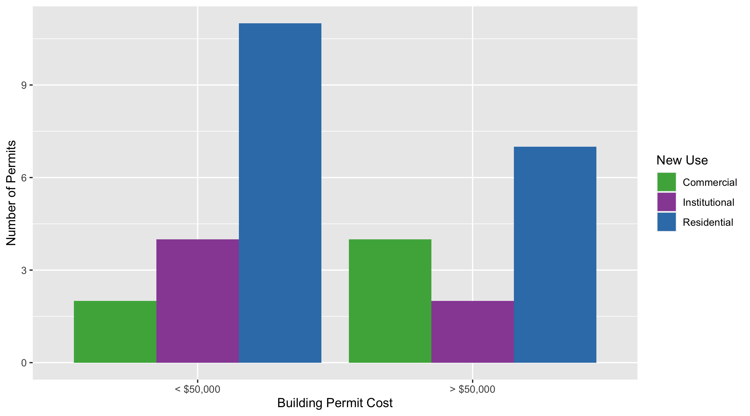
Central West End Permit Cost Breakdown

Slide 10
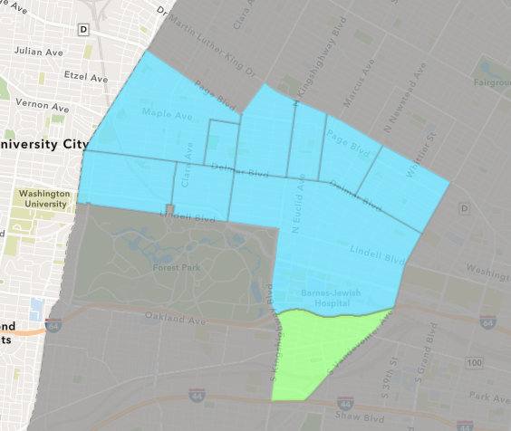
Forest Park Southeast
January 2021 Neighborhood Cost Breakdown
Mean: $142,123
Median: $140,000
Range: $1,200 - $863,907

Slide 11
Forest Park Southeast: Summary Notes
23 building permits in January 2021
155.56% change compared to January 2020 (9 total building permits)
$142,123: Average building permit cost in January 2021
134.21% change compared to January 2020 ($60,682)
23 total building permits in 2021
155.56% change YTD compared to this time in 2020 (9 total building permits)
$142,123: YTD average building permit cost in 2021
134.21% change YTD compared to this time in 2020 ($60,682)

Slide 12
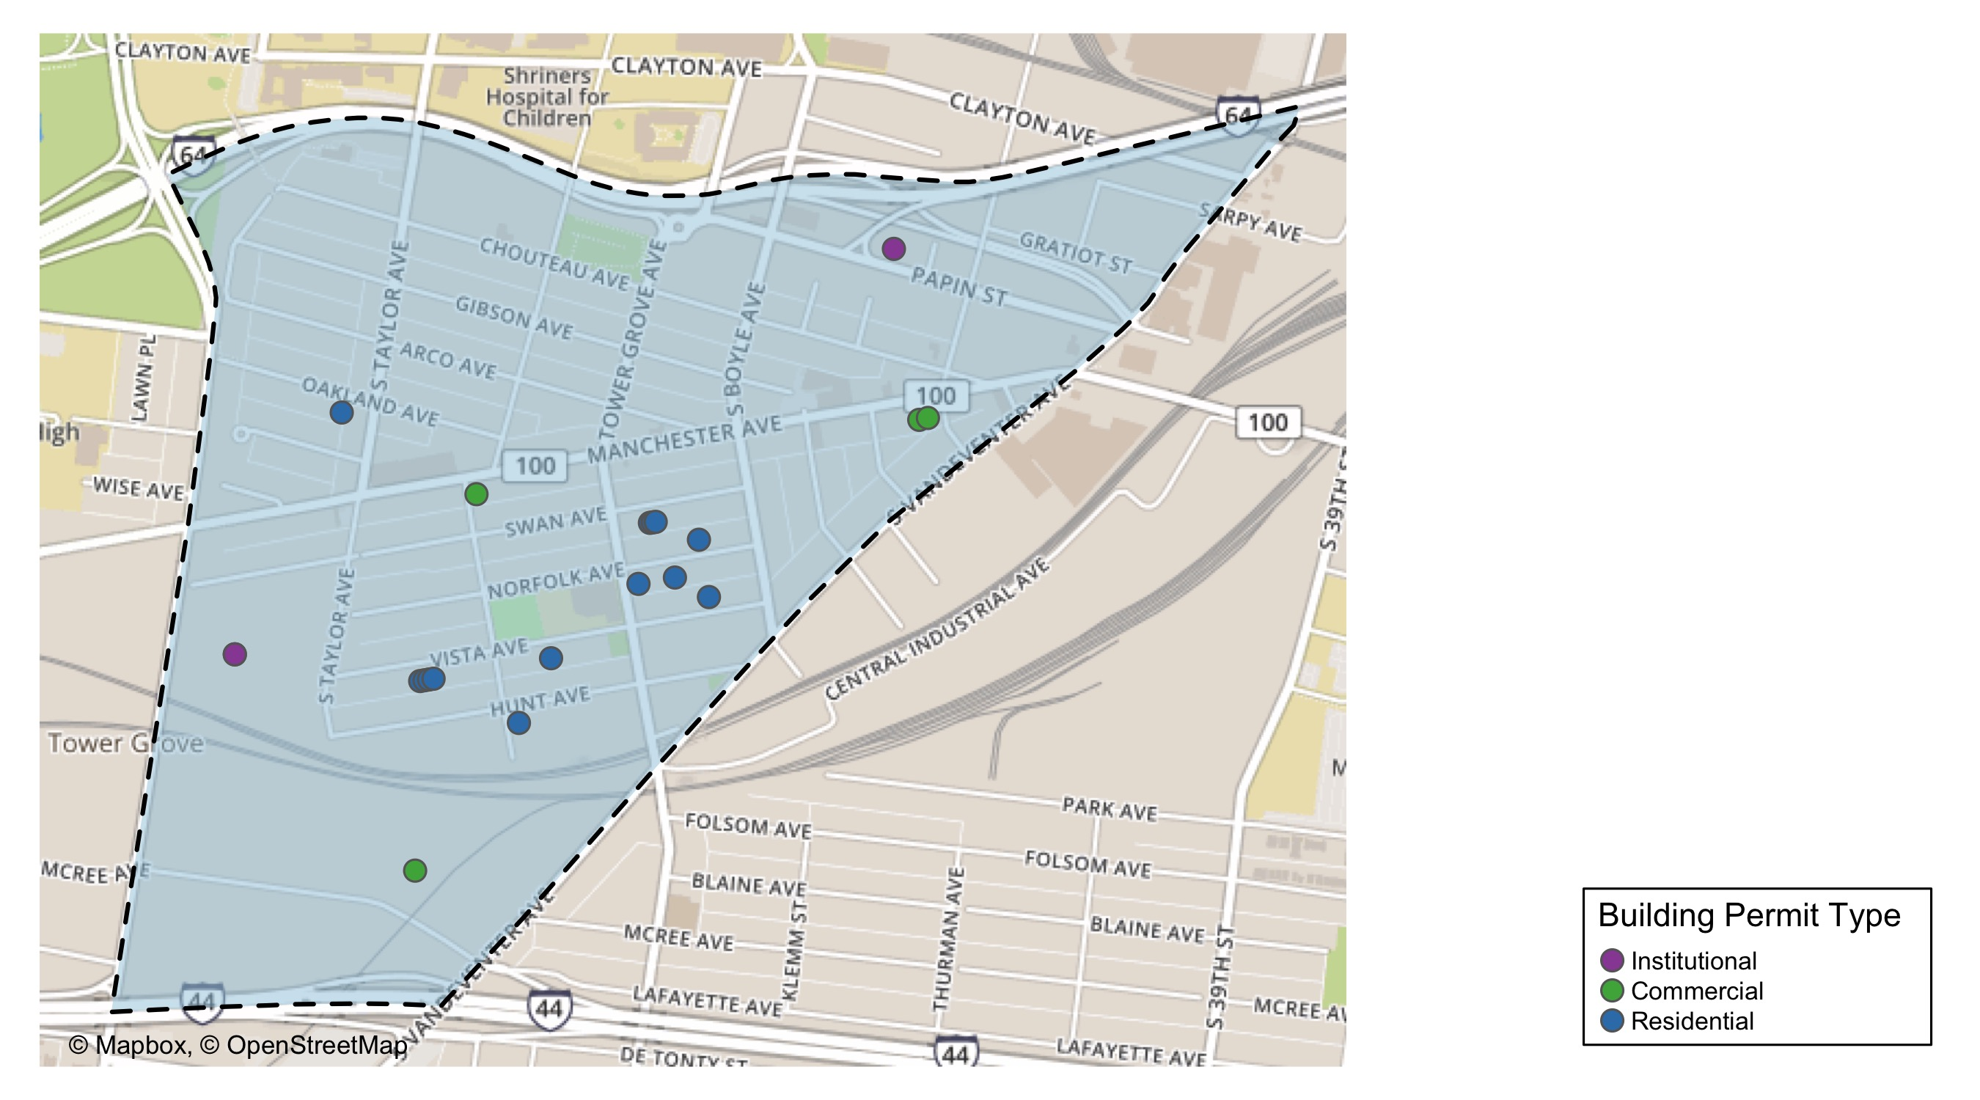
Forest Park Southeast

Slide 13
Neighborhood Summary
January 2021 | January 2021 | January 2021 | January 2021
Permit Use | Average Cost | # of Permits | Total Value of Permits
Commercial | $45,293 | 4 | $181,171
Industrial | $0 | 0 | $0
Institutional | $358,501 | 3 | $1,075,503
Residential | $125,760 | 16 | $2,012,153
Last 6 Months | Last 6 Months | Last 6 Months | Last 6 Months
Permit Use | Average Cost | # of Permits | Total Value of Permits
Commercial | $87,957 | 17 | $1,495,271
Industrial | $6,100 | 1 | $6,100
Institutional | $568,655 | 10 | $5,686,552
Residential | $5,696,439 | 57 | $324,697,045

Slide 14
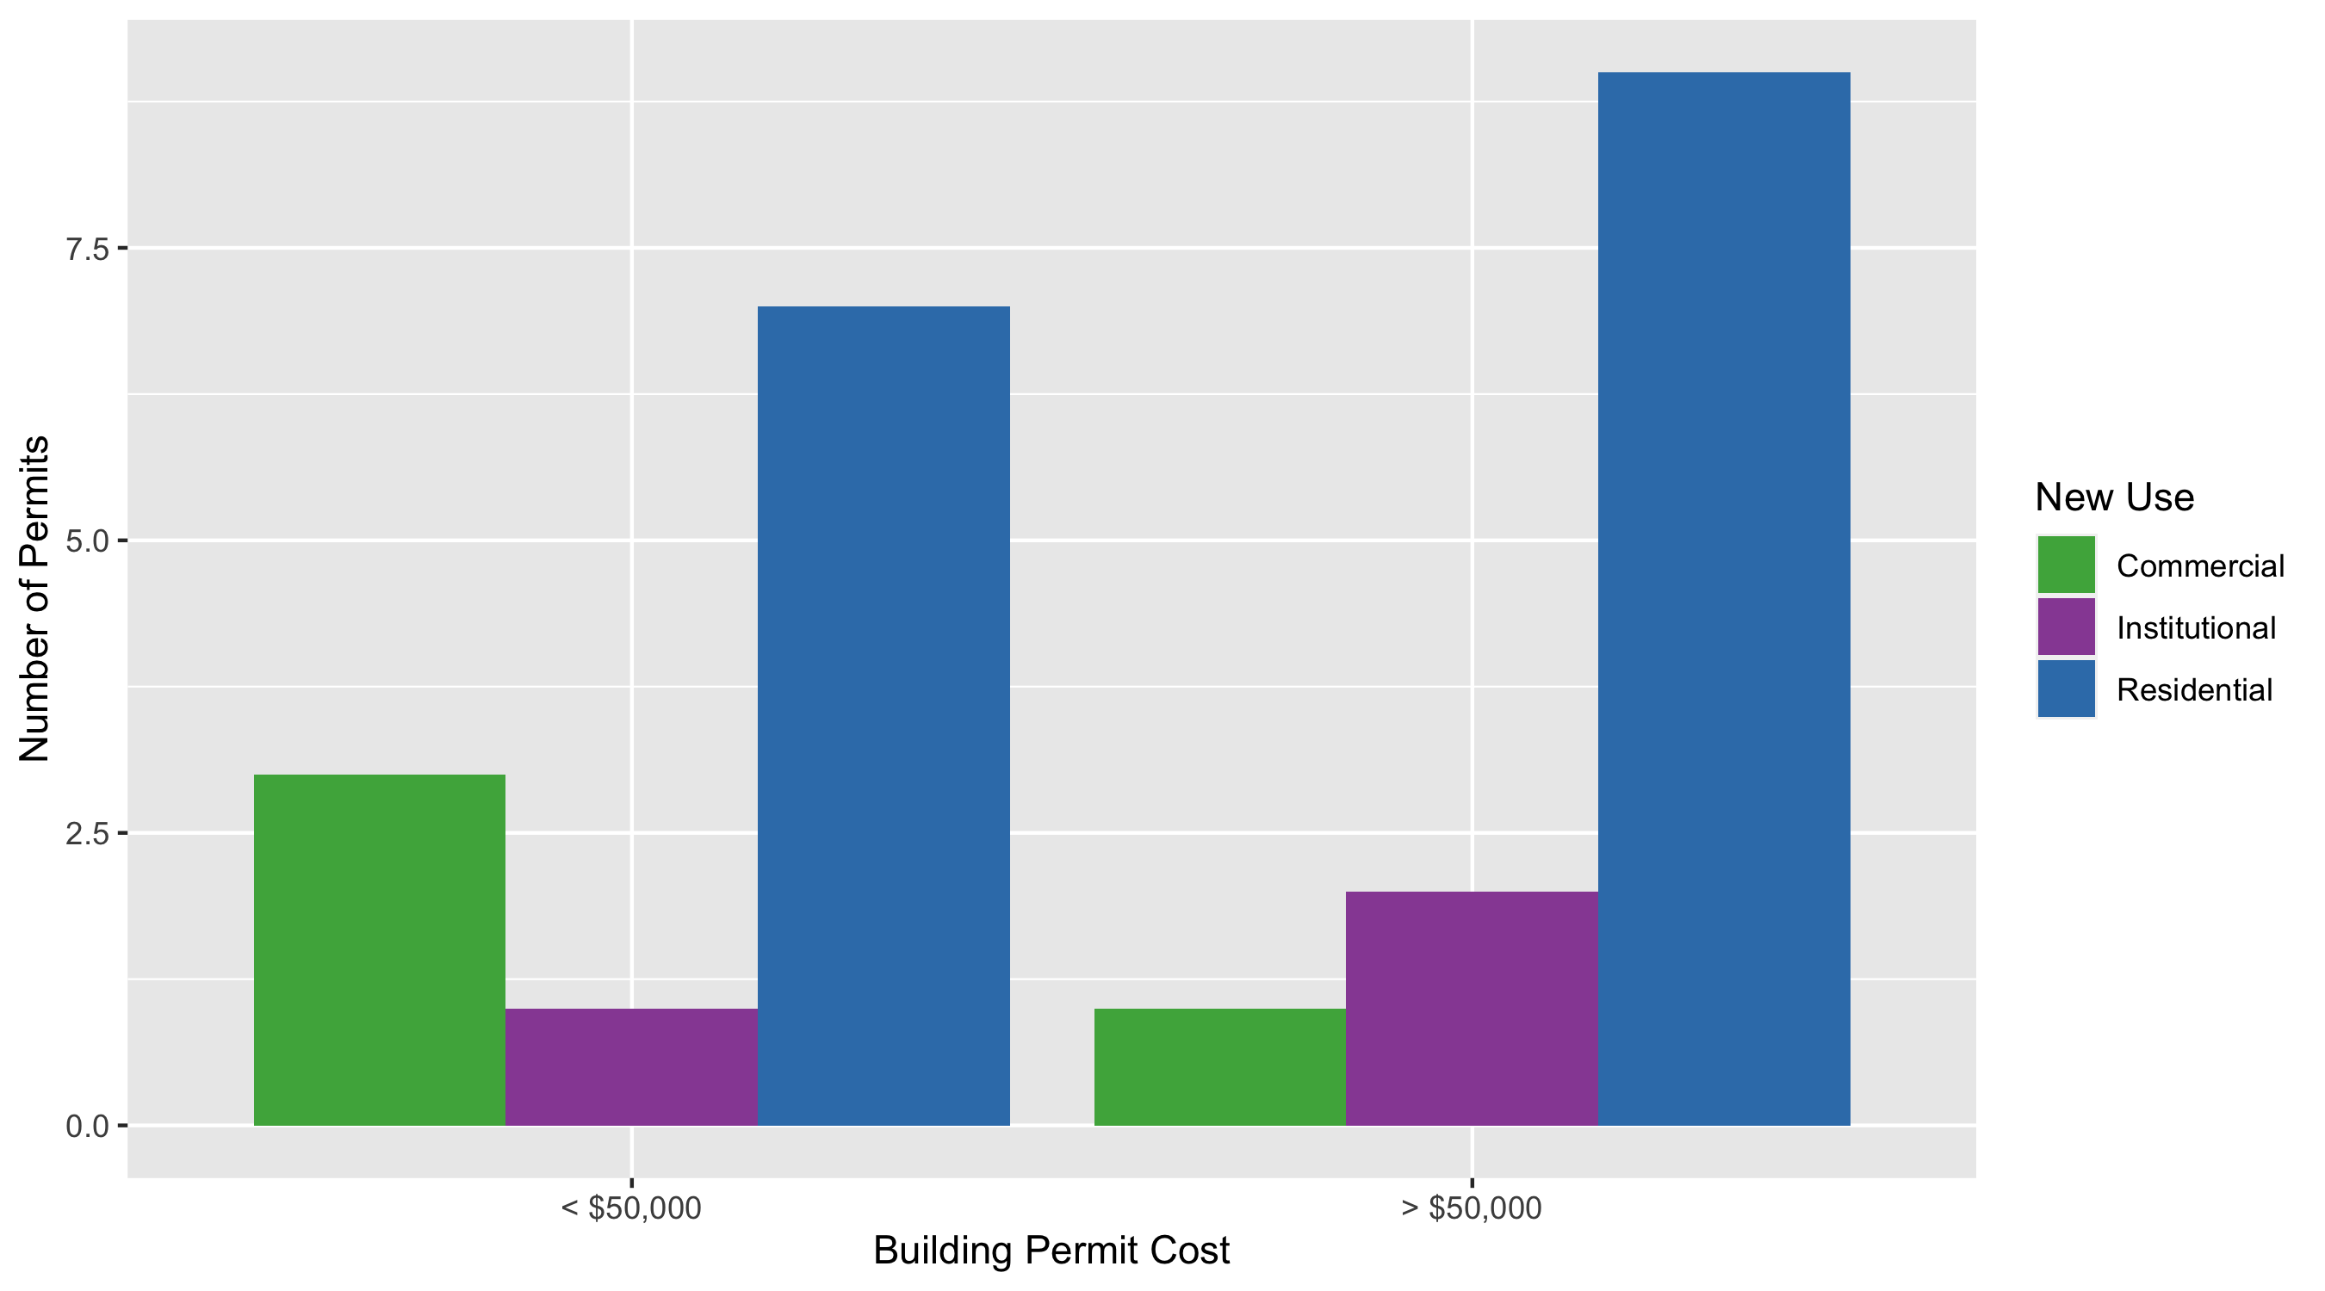
Forest Park Southeast Permit Cost Breakdown

Slide 15
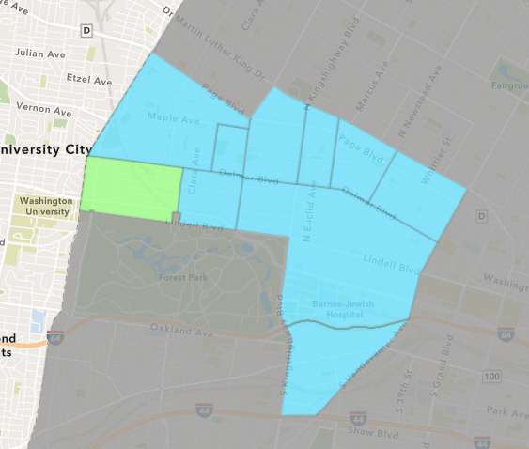
Skinker DeBaliviere
January 2021 Neighborhood Cost Breakdown
Mean: $42,478
Median: $26,000
Range: $400 - $200,000

Slide 16
Skinker DeBaliviere: Summary Notes
14 building permits in January 2021
100.00% change compared to January 2020 (7 total building permits)
$42,478: Average building permit cost in January 2021
54.07% change compared to January 2020 ($27,571)
14 total building permits in 2021
100.00% change YTD compared to this time in 2020 (7 total building permits)
$42,478: YTD average building permit cost in 2021
54.07% change YTD compared to this time in 2020 ($27,571)

Slide 17
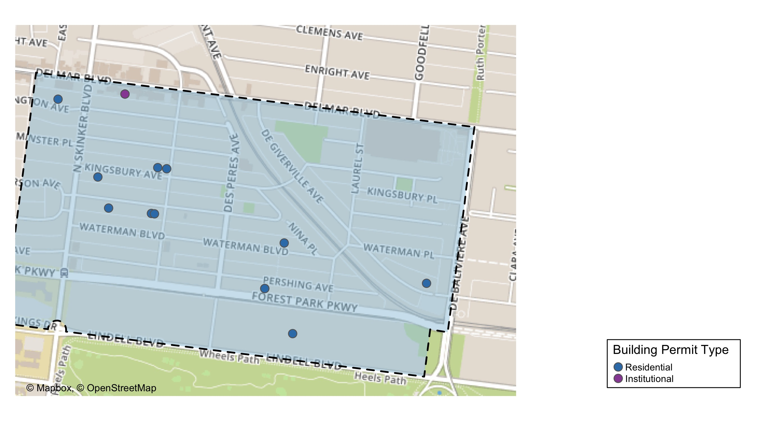
Skinker DeBaliviere

Slide 18
Neighborhood Summary
January 2021 | January 2021 | January 2021 | January 2021
Permit Use | Average Cost | # of Permits | Total Value of Permits
Commercial | $0 | 0 | $0
Industrial | $0 | 0 | $0
Institutional | $21,124 | 2 | $42,248
Residential | $46,037 | 12 | $552,444
Last 6 Months | Last 6 Months | Last 6 Months | Last 6 Months
Permit Use | Average Cost | # of Permits | Total Value of Permits
Commercial | $86,068 | 8 | $688,540
Industrial | $0 | 0 | $0
Institutional | $215,725 | 6 | $1,294,349
Residential | $34,127 | 46 | $1,569,825

Slide 19
Skinker DeBaliviere Individual Permit Breakdown
Owner | New Use | Cost | address
RUDLOFF, MARY ANNE TRSTE | Residential | $18,297 | 6115 KINGSBURY AV
JACOBS, MARK I & CHANAYA N | Residential | $25,000 | 6229 WASHINGTON AV
BURTON, KENNETH W & PATRICIA J | Residential | $30,000 | 6101 KINGSBURY AV
KURTZ, PAUL B & KATHERINE N | Residential | $6,300 | 6178 KINGSBURY AV
LUTJENS, JEFFREY K | Residential | $400 | 5727 DEGIVERVILLE AV
THOMPSON, GREGG MICHAEL & | Residential | $35,000 | 6160 MCPHERSON AV
ONE WORLD USA LLC | Residential | $80,000 | 5912 PERSHING AV
COLETTE EDSON | Residential | $5,447 | 6108 MCPHERSON AV
CHURCH BUILDING LLC | Institutional | $15,248 | 6166 DELMAR BLVD
WEIS, KIRSTEN & RAVI CHOPRA | Residential | $30,000 | 6112 MCPHERSON AV
SAMUELS, DAVID & VICTORIA | Residential | $200,000 | 5835 LINDELL BLVD
MENDICINO ENTERPRISES LLC | Residential | $120,000 | 5857 WATERMAN BLVD
ONE WORLD USA LLC | Residential | $2,000 | 5912 PERSHING AV
CHURCH BUILDING LLC | Institutional | $27,000 | 6166 DELMAR BLVD

Slide 20
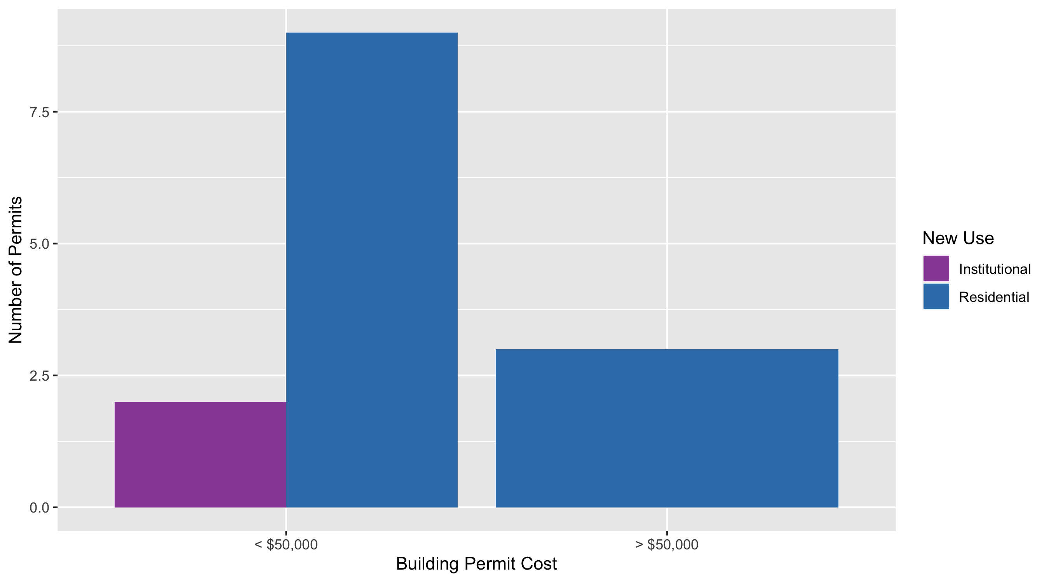
Skinker DeBaliviere Permit Cost Breakdown

Slide 21
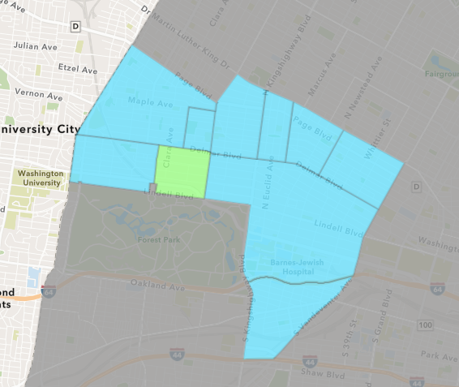
DeBaliviere Place
January 2021 Neighborhood Cost Breakdown
Mean: $31,735
Median: $30,000
Range: $13,854 - $51,350

Slide 22
DeBaliviere Place: Summary Notes
3 building permits in January 2021
-25.00% change compared to January 2020 (4 total building permits)
$31,735: Average building permit cost in January 2021
-99.30% change compared to January 2020 ($4,512,000)
3 total building permits in 2021
-25.00% change YTD compared to this time in 2020 (4 total building permits)
$31,735: YTD average building permit cost in 2021
-99.30% change YTD compared to this time in 2020 ($4,512,000)

Slide 23
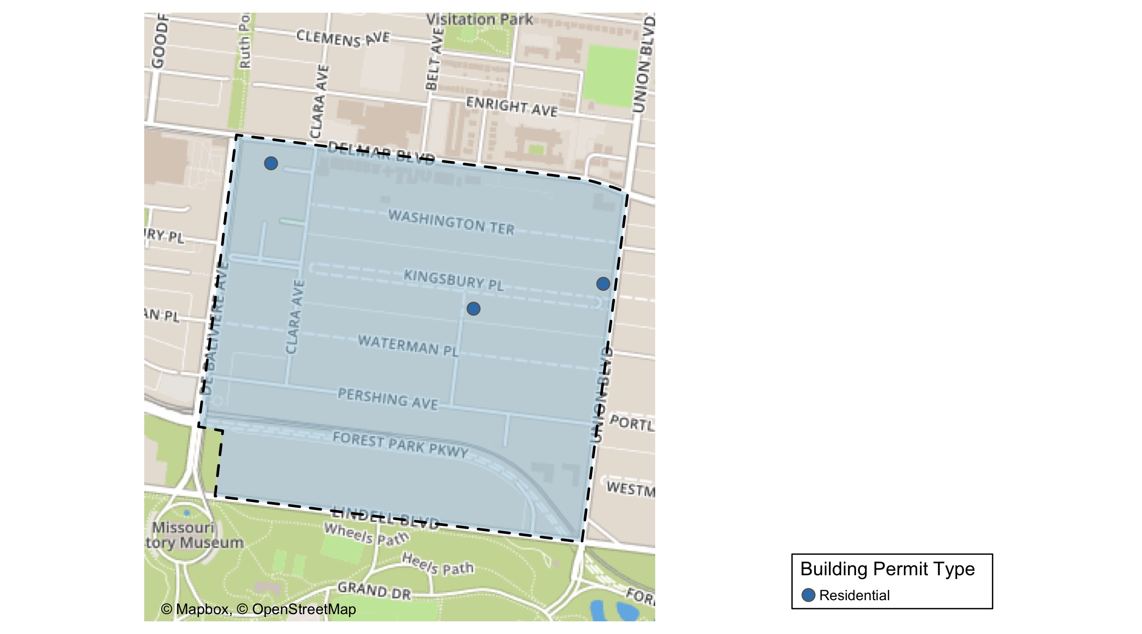
DeBaliviere Place

Slide 24
Neighborhood Summary
January 2021 | January 2021 | January 2021 | January 2021
Permit Use | Average Cost | # of Permits | Total Value of Permits
Commercial | $0 | 0 | $0
Industrial | $0 | 0 | $0
Institutional | $0 | 0 | $0
Residential | $31,735 | 3 | $95,204
Last 6 Months | Last 6 Months | Last 6 Months | Last 6 Months
Permit Use | Average Cost | # of Permits | Total Value of Permits
Commercial | $7,890 | 2 | $15,780
Industrial | $0 | 0 | $0
Institutional | $0 | 0 | $0
Residential | $378,877 | 34 | $12,881,821

Slide 25
DeBaliviere Place Individual Permit Breakdown
Owner | New Use | Cost | address
BUFORD, JAMES H & SUSAN E | Residential | $13,854 | 1 KINGSBURY PL
DEL MONTE APARTMENTS LLC | Residential | $30,000 | 5622 DELMAR BLVD
GREGORY, PETER | Residential | $51,350 | 22 KINGSBURY PL

Slide 26
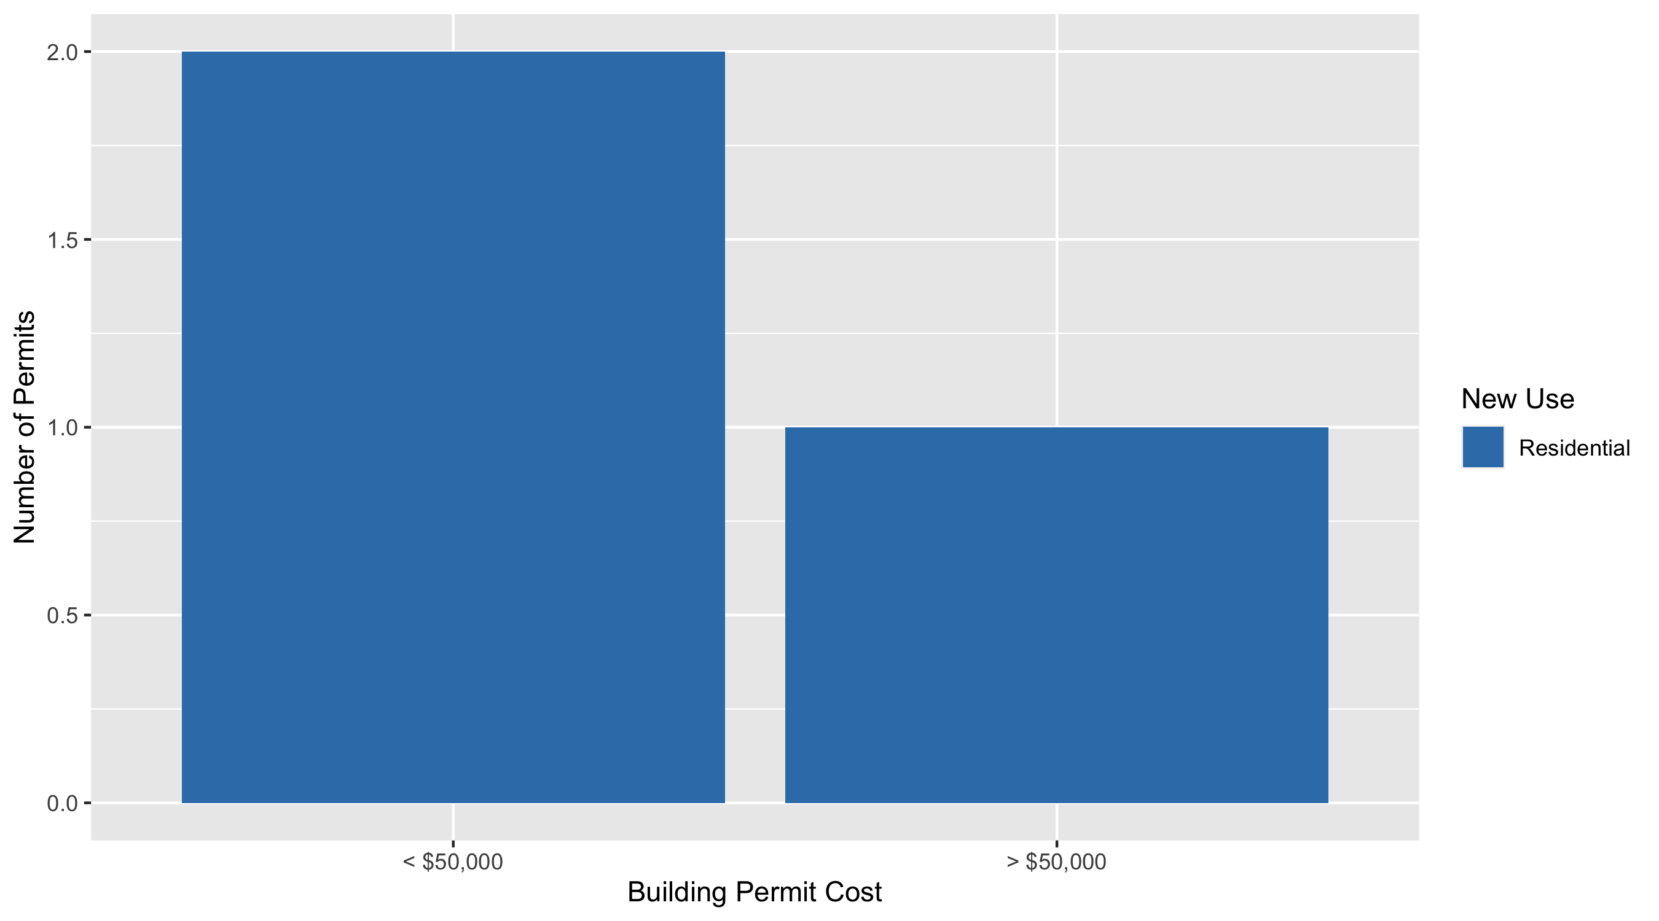
DeBaliviere Place Permit Cost Breakdown

Slide 27
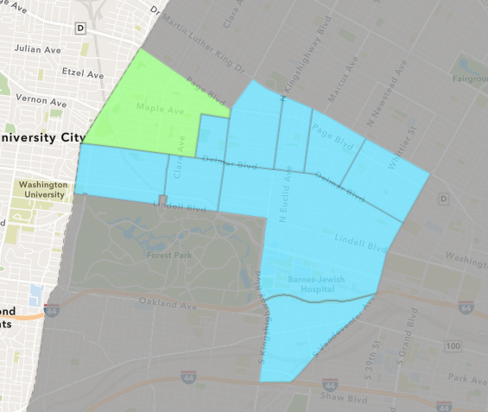
West End
January 2021 Neighborhood Cost Breakdown
Mean: $101,310
Median: $9,500
Range: $4,000 - $590,847

Slide 28
West End: Summary Notes
7 building permits in January 2021
-30.00% change compared to January 2020 (10 total building permits)
$101,310: Average building permit cost in January 2021
1166.37% change compared to January 2020 ($8,000)
7 total building permits in 2021
-30.00% change YTD compared to this time in 2020 (10 total building permits)
$101,310: YTD average building permit cost in 2021
1166.37% change YTD compared to this time in 2020 ($8,000)

Slide 29
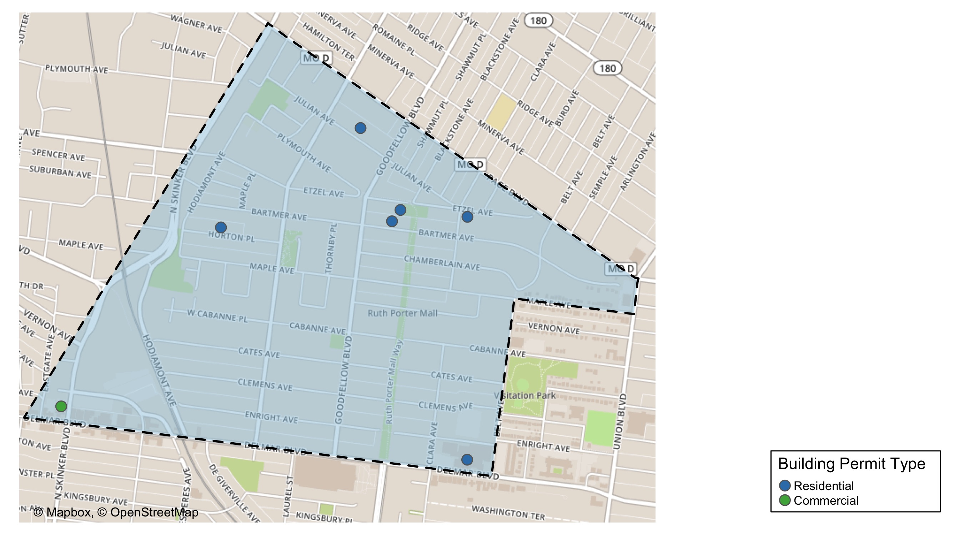
West End

Slide 30
Neighborhood Summary
January 2021 | January 2021 | January 2021 | January 2021
Permit Use | Average Cost | # of Permits | Total Value of Permits
Commercial | $4,000 | 1 | $4,000
Industrial | $0 | 0 | $0
Institutional | $0 | 0 | $0
Residential | $117,528 | 6 | $705,167
Last 6 Months | Last 6 Months | Last 6 Months | Last 6 Months
Permit Use | Average Cost | # of Permits | Total Value of Permits
Commercial | $26,548 | 9 | $238,930
Industrial | $0 | 0 | $0
Institutional | $521,018 | 2 | $1,042,035
Residential | $75,211 | 40 | $3,008,442

Slide 31
West End Individual Permit Breakdown
Owner | New Use | Cost | address
PURNELL, JOANIE D | Residential | $9,500 | 6015 HORTON PL
DELMAR DIVINE MASTER LANDLORD COMMER | Residential | $590,847 | 5535 DELMAR BLVD
OLIVER, LINDA S | Residential | $68,000 | 5716 ETZEL AV
CARADINE, LAVELL | Residential | $4,700 | 5727 BARTMER AV
PACE-DELMAR ASSOCIATES LLC | Commercial | $4,000 | 6217 DELMAR BLVD
DENT, VAUGHN J | Residential | $8,520 | 5598 ETZEL AV
WILLIAMS, JOSEPH & ANN | Residential | $23,600 | 5853 JULIAN AV

Slide 32
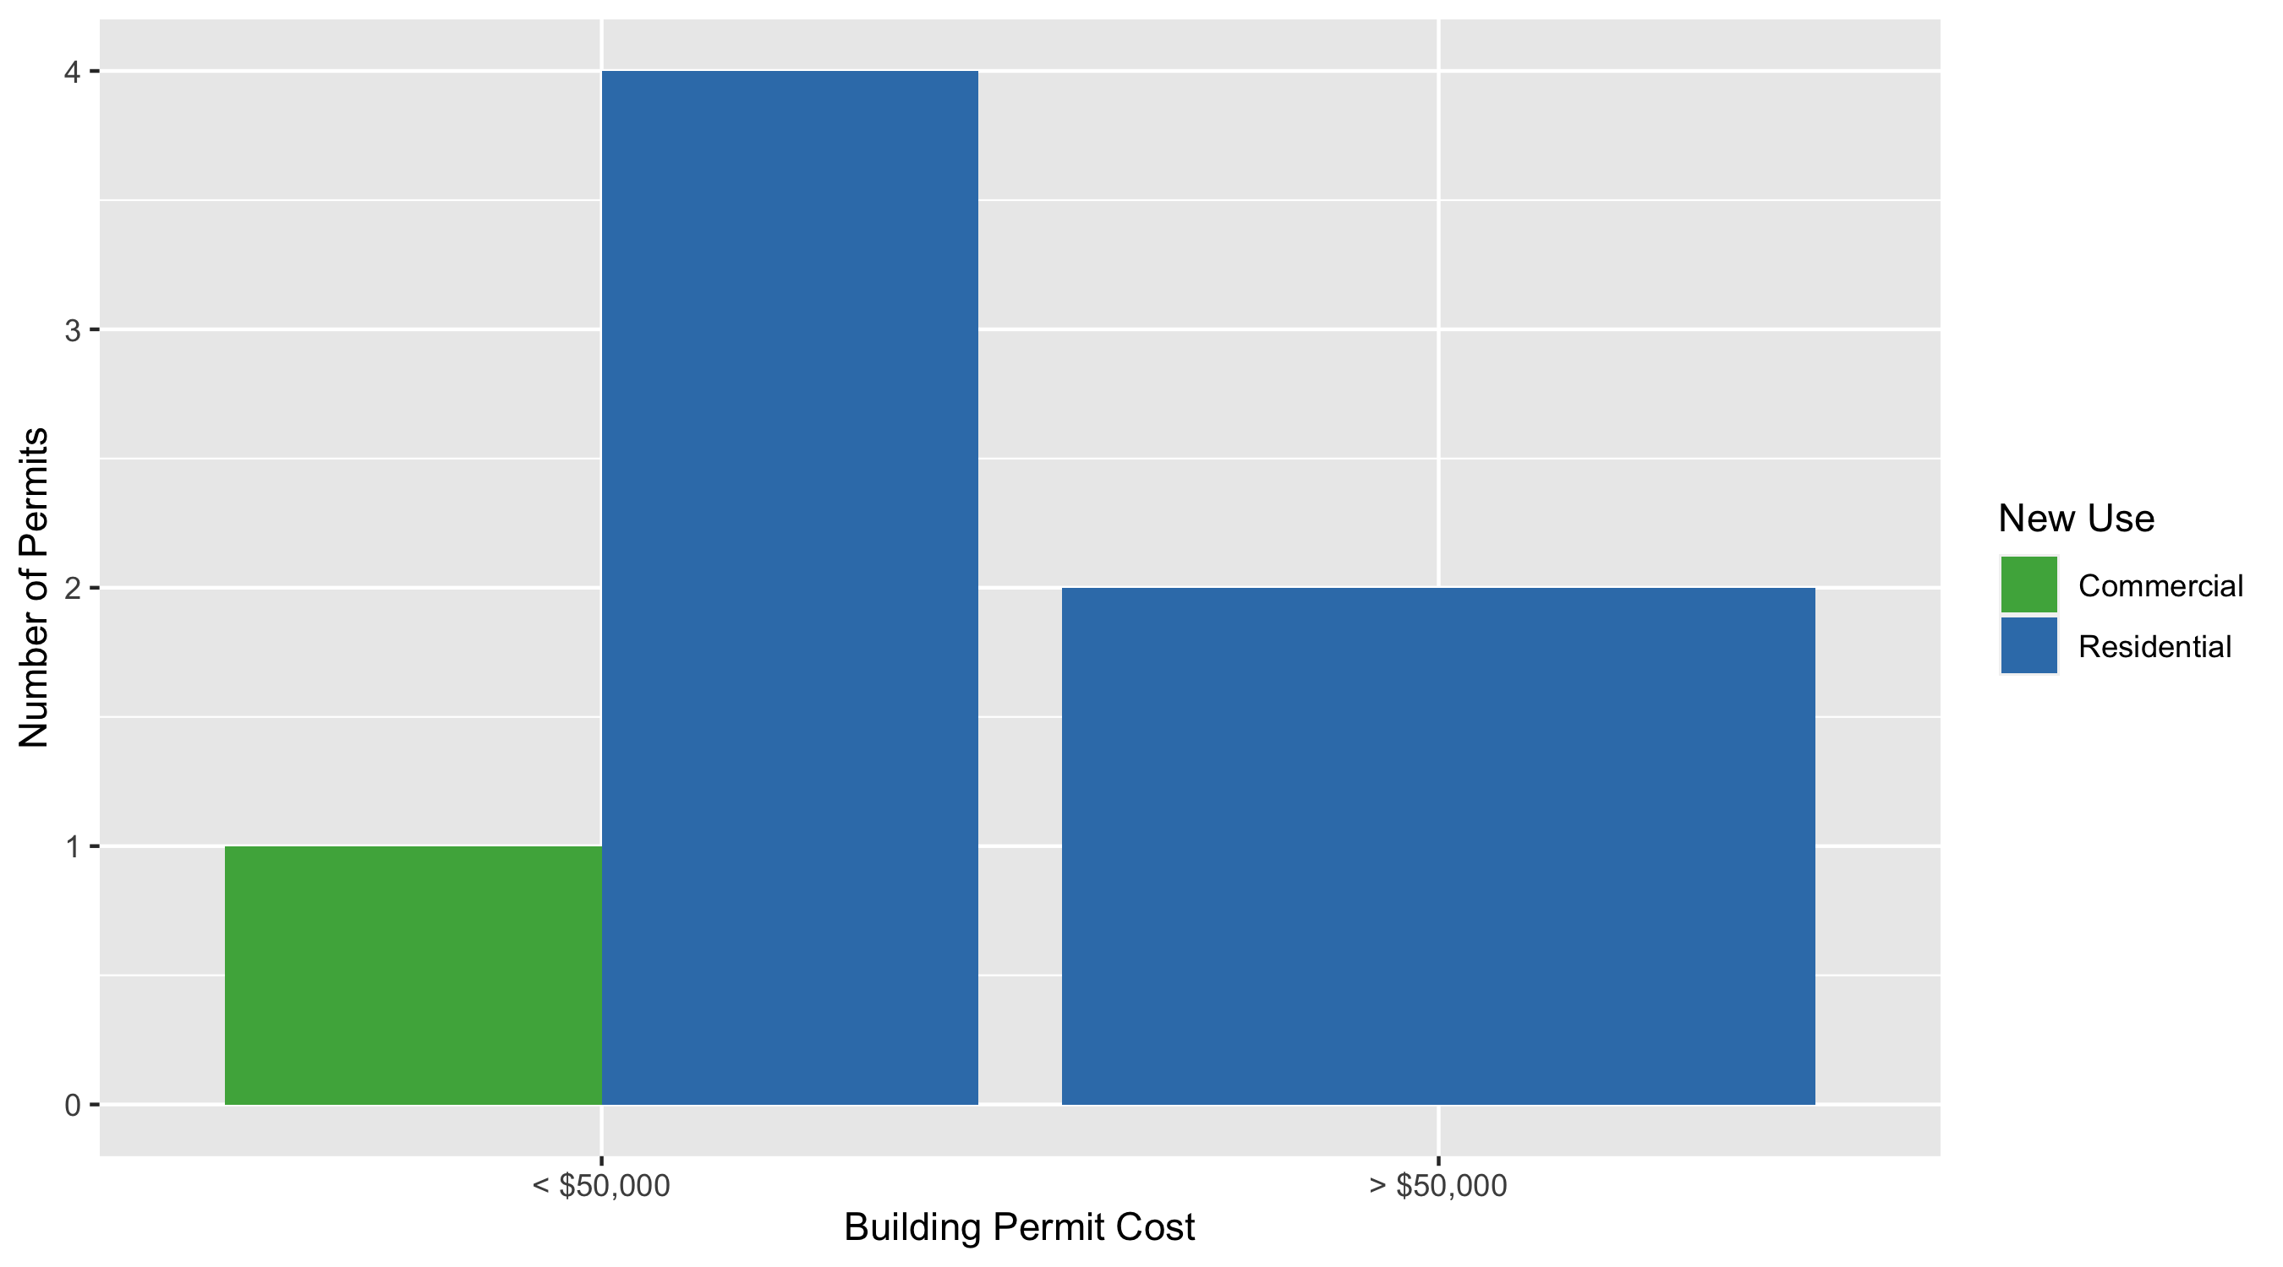
West End Permit Cost Breakdown

Slide 33
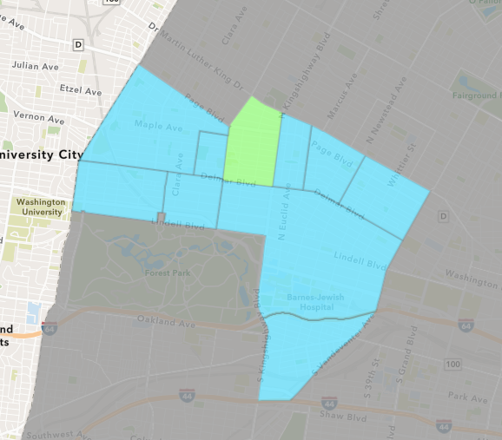
Academy
January 2021 Neighborhood Cost Breakdown
Mean: $4,475
Median: $4,475
Range: $4,475 - $4,475

Slide 34
Academy: Summary Notes
1 building permits in January 2021
-83.33% change compared to January 2020 (6 total building permits)
$4,475: Average building permit cost in January 2021
-94.79% change compared to January 2020 ($85,825)
1 total building permits in 2021
-83.33% change YTD compared to this time in 2020 (6 total building permits)
$4,475: YTD average building permit cost in 2021
-94.79% change YTD compared to this time in 2020 ($85,825)

Slide 35
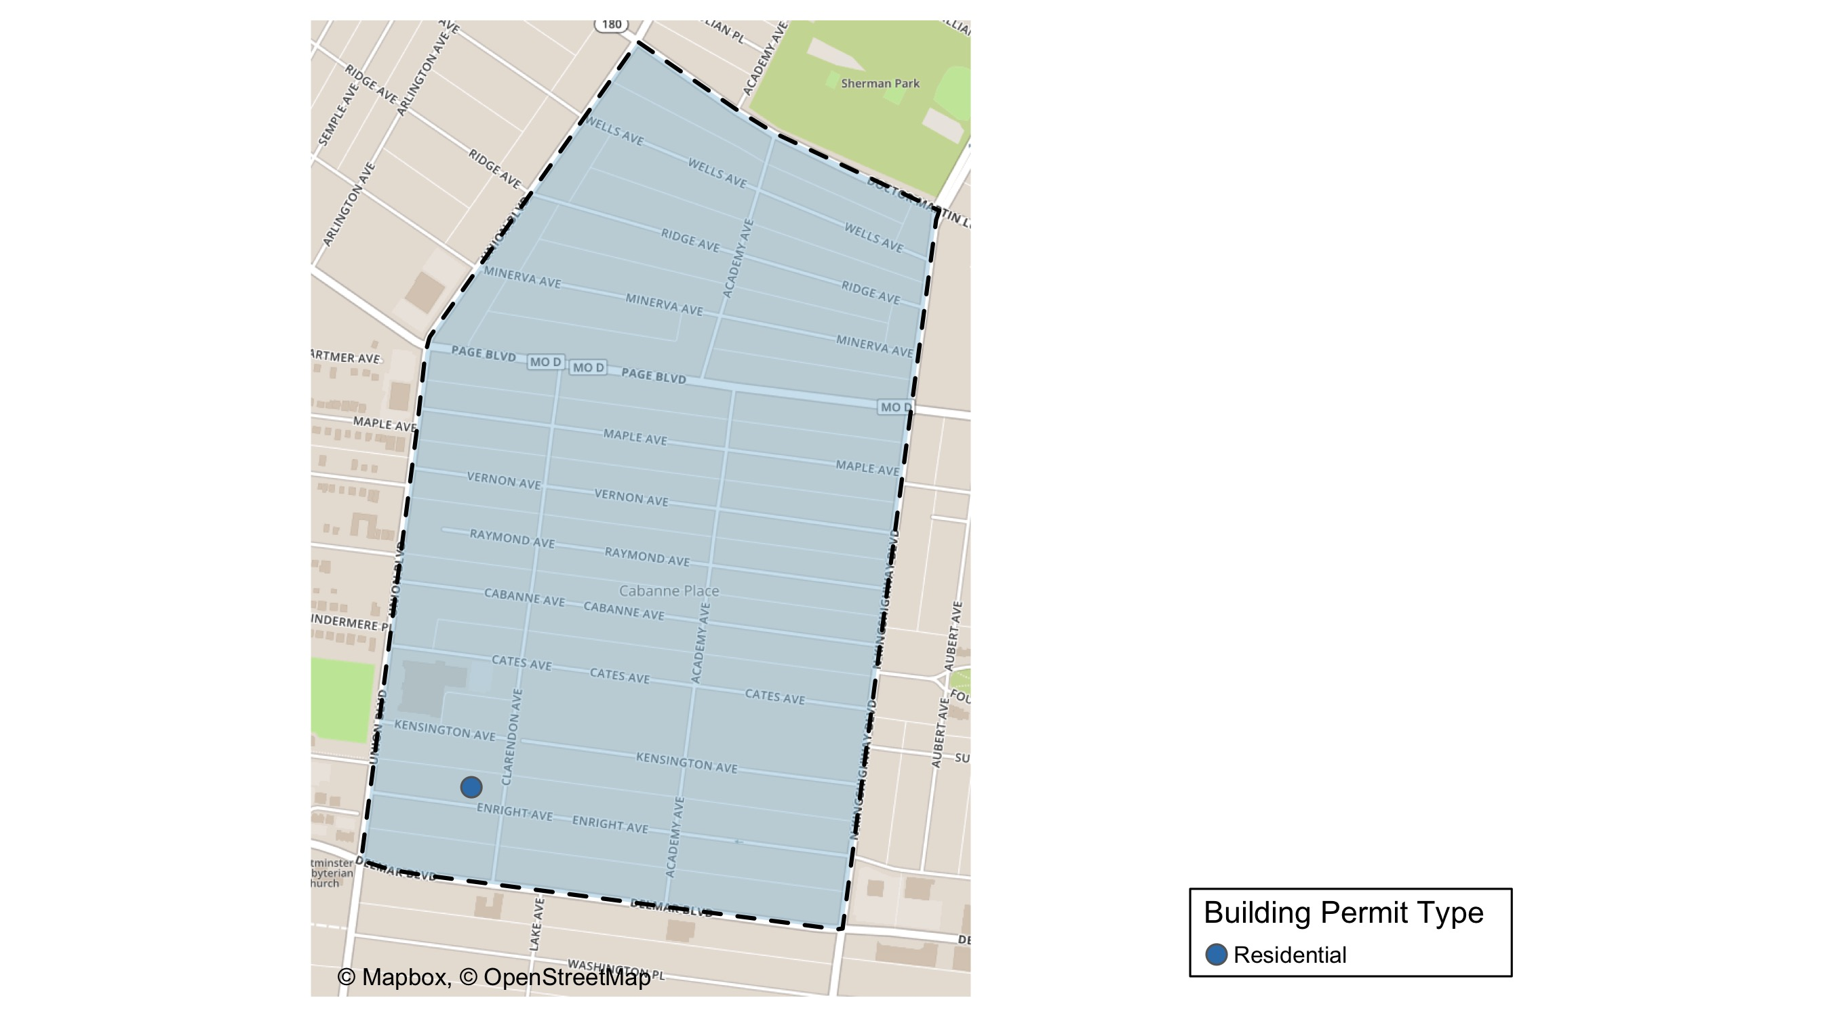
Academy

Slide 36
Neighborhood Summary
January 2021 | January 2021 | January 2021 | January 2021
Permit Use | Average Cost | # of Permits | Total Value of Permits
Commercial | $0 | 0 | $0
Industrial | $0 | 0 | $0
Institutional | $0 | 0 | $0
Residential | $4,475 | 1 | $4,475
Last 6 Months | Last 6 Months | Last 6 Months | Last 6 Months
Permit Use | Average Cost | # of Permits | Total Value of Permits
Commercial | $15,000 | 1 | $15,000
Industrial | $0 | 0 | $0
Institutional | $5,250 | 2 | $10,500
Residential | $27,702 | 20 | $554,044

Slide 37
Academy Individual Permit Breakdown
Owner | New Use | Cost | address
SYMS, MELBA DEE JOHNSON | Residential | $4,475 | 5217 ENRIGHT AV

Slide 38
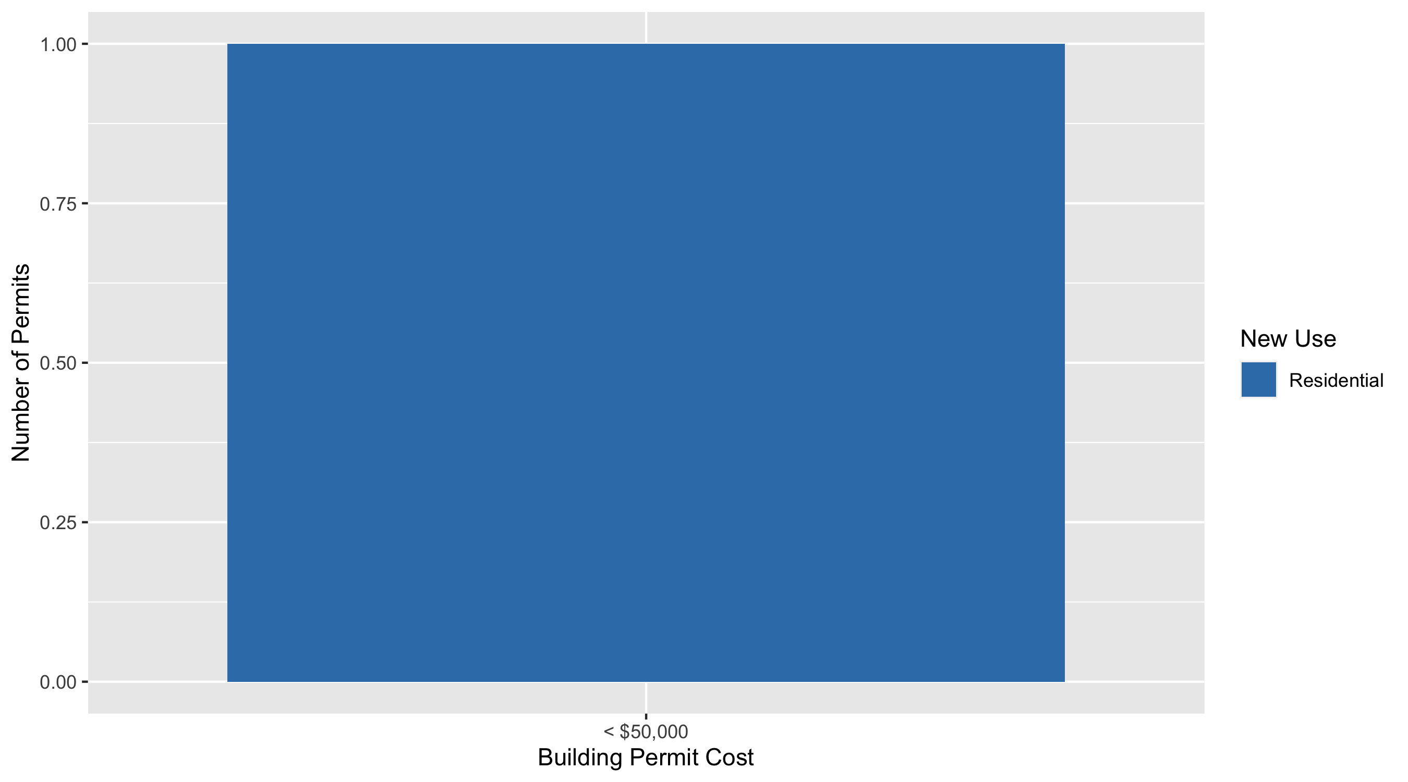
Academy Permit Cost Breakdown

Slide 39
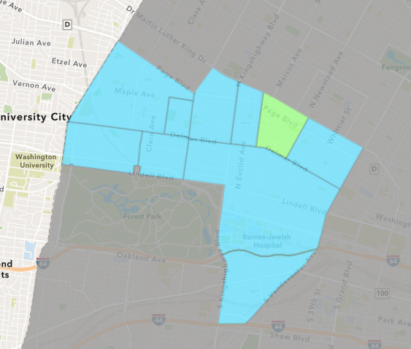
Lewis Place
January 2021 Neighborhood Cost Breakdown
Mean: $54,867
Median: $8,600
Range: $6,000 - $150,000

Slide 40
Lewis Place: Summary Notes
3 building permits in January 2021
200.00% change compared to January 2020 (1 total building permits)
$54,867: Average building permit cost in January 2021
2094.67% change compared to January 2020 ($2,500)
3 total building permits in 2021
200.00% change YTD compared to this time in 2020 (1 total building permits)
$54,867: YTD average building permit cost in 2021
2094.67% change YTD compared to this time in 2020 ($2,500)

Slide 41
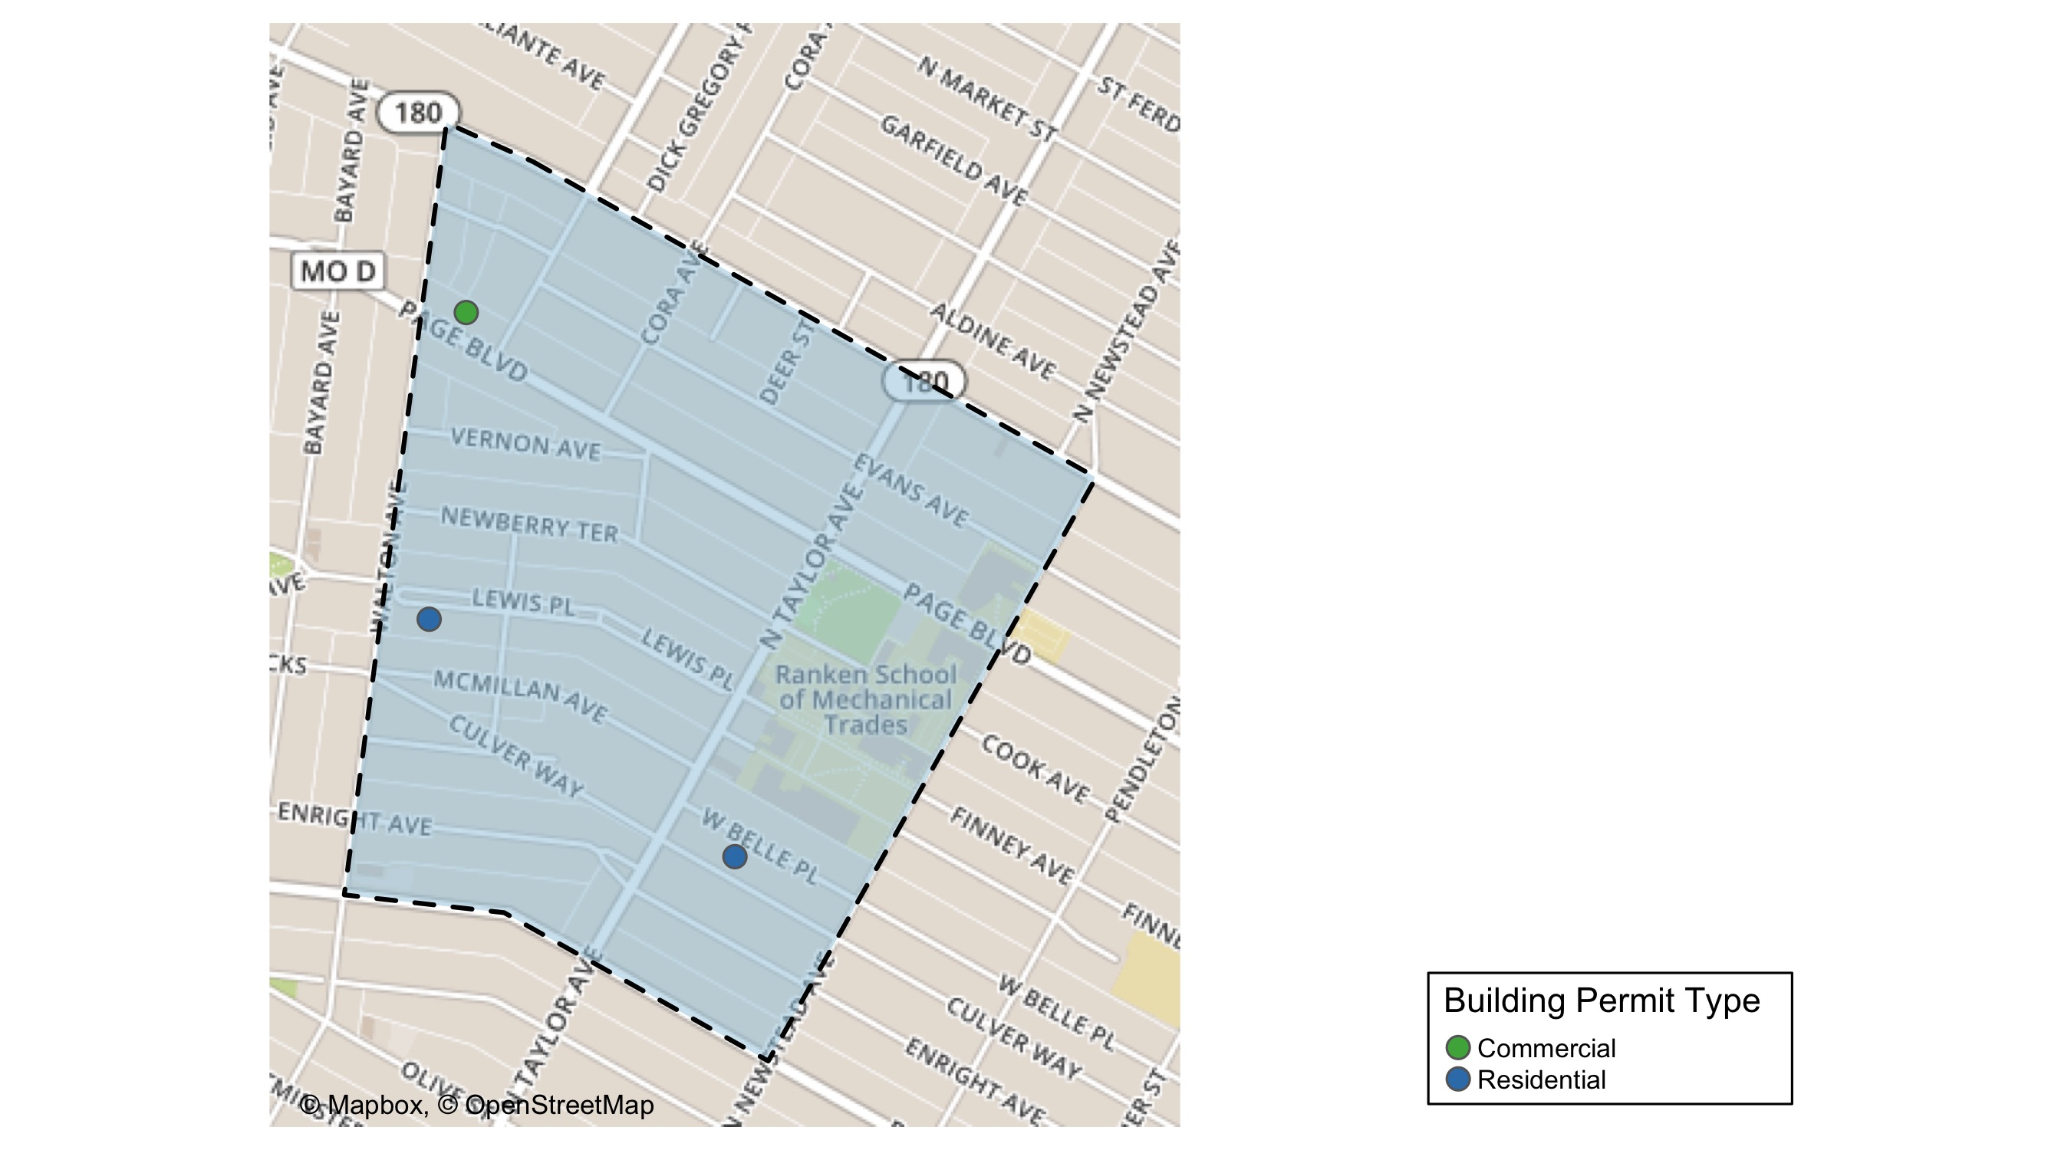
Lewis Place

Slide 42
Neighborhood Summary
January 2021 | January 2021 | January 2021 | January 2021
Permit Use | Average Cost | # of Permits | Total Value of Permits
Commercial | $6,000 | 1 | $6,000
Industrial | $0 | 0 | $0
Institutional | $0 | 0 | $0
Residential | $79,300 | 2 | $158,600
Last 6 Months | Last 6 Months | Last 6 Months | Last 6 Months
Permit Use | Average Cost | # of Permits | Total Value of Permits
Commercial | $8,000 | 2 | $16,000
Industrial | $0 | 0 | $0
Institutional | $10,000 | 1 | $10,000
Residential | $37,880 | 14 | $530,323

Slide 43
Lewis Place Individual Permit Breakdown
Owner | New Use | Cost | address
TAYLOR, GERRY & ROBYN | Commercial | $6,000 | 4721 PAGE BLVD
THOMAS, BRENDA | Residential | $8,600 | 4734 LEWIS PL
RANKEN TECHNICAL COLLEGE | Residential | $150,000 | 4458 WEST BELLE PL

Slide 44
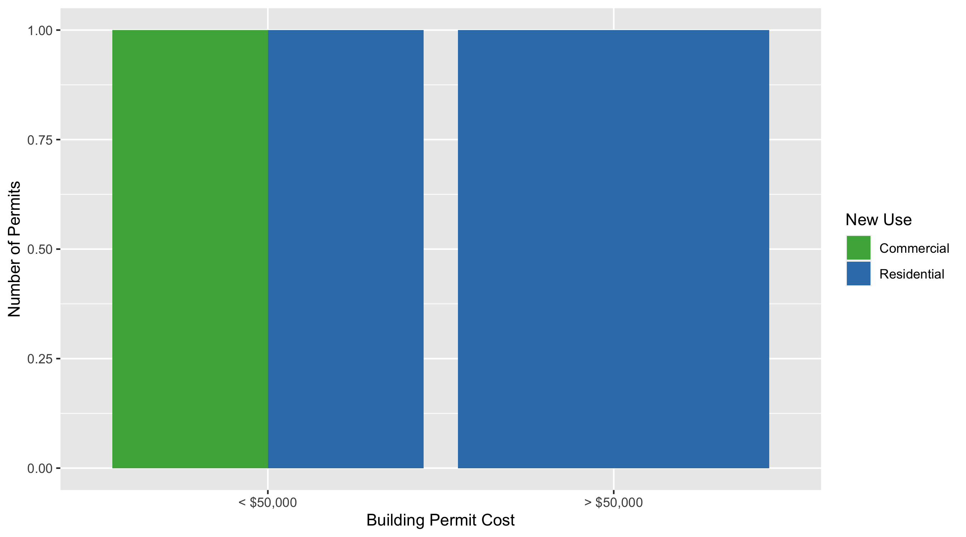
Lewis Place Permit Cost Breakdown

Slide 45
Additional Notes
Data retreived from https://www.stlouis-mo.gov/data/
Building permits with a cost of $0 were dropped
Building permits that were cancelled were dropped
Infinite change indicates 0 permits in the current or previous time period/comparison month so there was a overall increase or decrease

